Slide 1
CAS AML 2022 Reinforcement Learning
Advanced Reinforcement Learning
Dr. Lorenzo Brigato
Artificial Intelligence in Health and Nutrition (AIHN) Laboratory ARTORG Center for Biomedical Engineering Research University of Bern

Slide 2
Outlook
Value Function Approximation
Policy Gradient
Deep Reinforcement Learning
L. Brigato
Reinforcement Learning: Advanced RL
2

Slide 3
Value Function Approximation

Slide 4
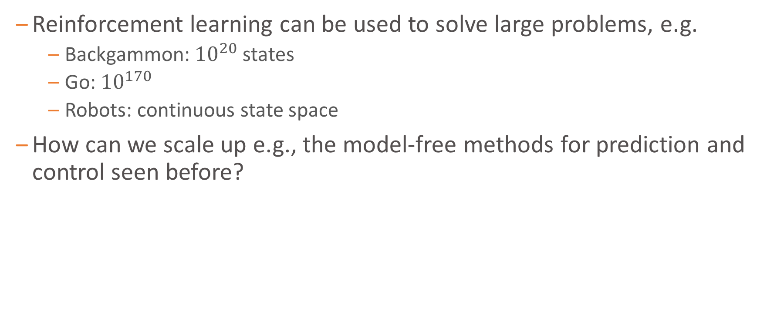
Large-Scale Reinforcement Learning
Reinforcement learning can be used to solve large problems, e.g.
Backgammon: ${10}^{20}$ states
Go: ${10}^{170}$
Robots: continuous state space
How can we scale up e.g., the model-free methods for prediction and control seen before?
L. Brigato
Reinforcement Learning: Advanced RL

Slide 5
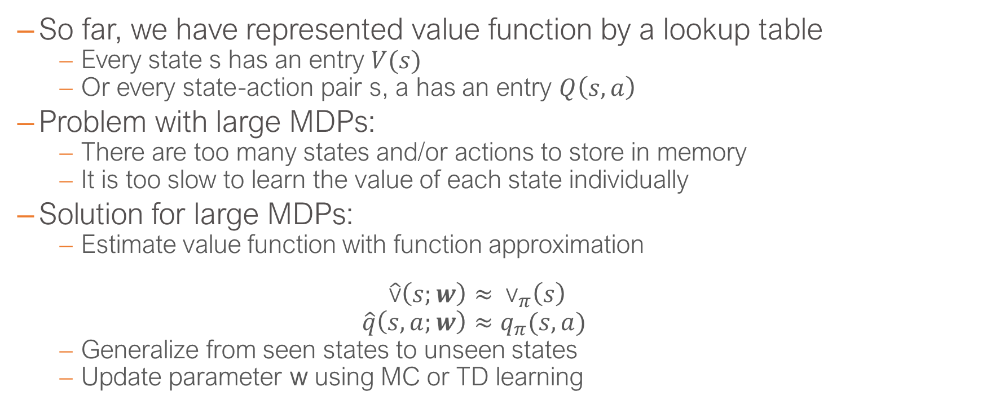
Value Function Approximation
So far, we have represented value function by a lookup table
Every state s has an entry $V(s)$
Or every state-action pair s, a has an entry $Q\left(s,a\right)$
Problem with large MDPs:
There are too many states and/or actions to store in memory
It is too slow to learn the value of each state individually
Solution for large MDPs:
Estimate value function with function approximation
$$\hat{\text{v}}\left(s;w\right)≈ {\text{v}}_{π}\left(s\right) \\ \hat{q}\left(s,a;w\right)≈q_{π}(s,a)$$
Generalize from seen states to unseen states
Update parameter w using MC or TD learning
L. Brigato
Reinforcement Learning: Advanced RL

Slide 6

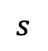
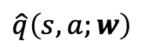
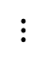

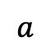
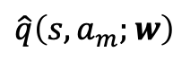

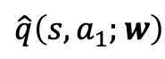
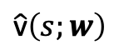
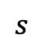
Types of Value Function Approximation
$$w$$
$$s$$
$$\hat{\text{v}}\left(s;w\right)$$
$$s$$
$$w$$
$$\hat{q}\left(s,a;w\right)$$
$$a$$
$$w$$
$$\hat{q}\left(s,a_{1};w\right)$$
$$s$$
$$⋮$$
$$\hat{q}\left(s,a_{m};w\right)$$
L. Brigato
Reinforcement Learning: Advanced RL

Slide 7
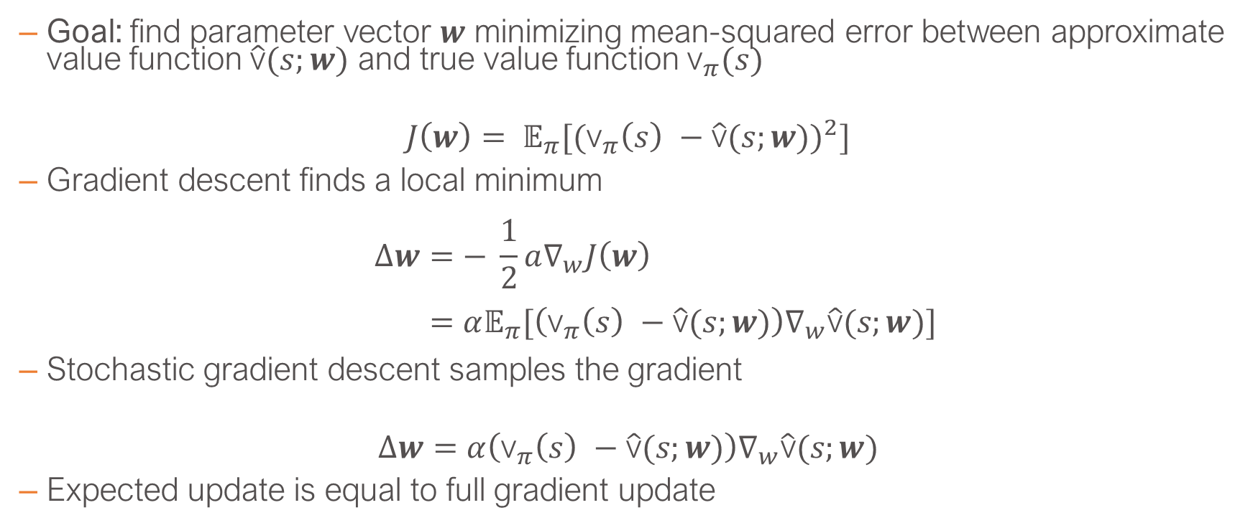
Value Function Approx. By Stochastic Gradient Descent
Goal: find parameter vector $w$ minimizing mean-squared error between approximate value function $\hat{\text{v}}(s;w)$ and true value function ${\text{v}}_{π}(s)$
$$J\left(w\right)= 𝔼_{π}[{({\text{v}}_{π}\left(s\right) −\hat{\text{v}}(s;w))}^{2}]$$
Gradient descent finds a local minimum
$$∆w=− \frac{1}{2}a∇_{w}J\left(w\right) \\ =α𝔼_{π}[\left({\text{v}}_{π}\left(s\right) −\hat{\text{v}}(s;w)\right)∇_{w}\hat{\text{v}}(s;w)]$$
Stochastic gradient descent samples the gradient
$$∆w=α\left({\text{v}}_{π}\left(s\right) −\hat{\text{v}}(s;w)\right)∇_{w}\hat{\text{v}}(s;w)$$
Expected update is equal to full gradient update
L. Brigato
Reinforcement Learning: Advanced RL

Slide 8
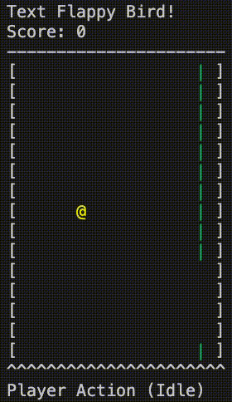
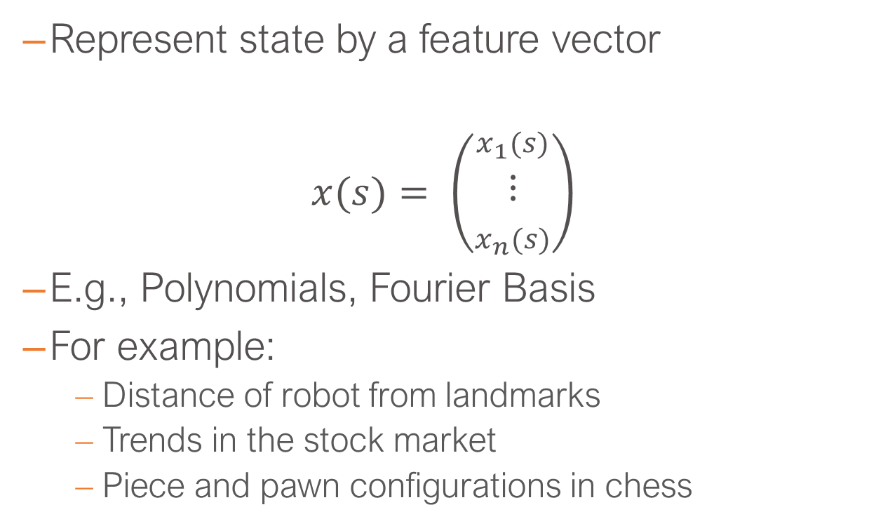
Feature Vectors
Represent state by a feature vector
$x(s)= \left(\begin{matrix}x_{1}(s) \\ ⋮ \\ x_{n}(s)\end{matrix}\right)$
E.g., Polynomials, Fourier Basis
For example:
Distance of robot from landmarks
Trends in the stock market
Piece and pawn configurations in chess
L. Brigato
Reinforcement Learning: Advanced RL

Slide 9
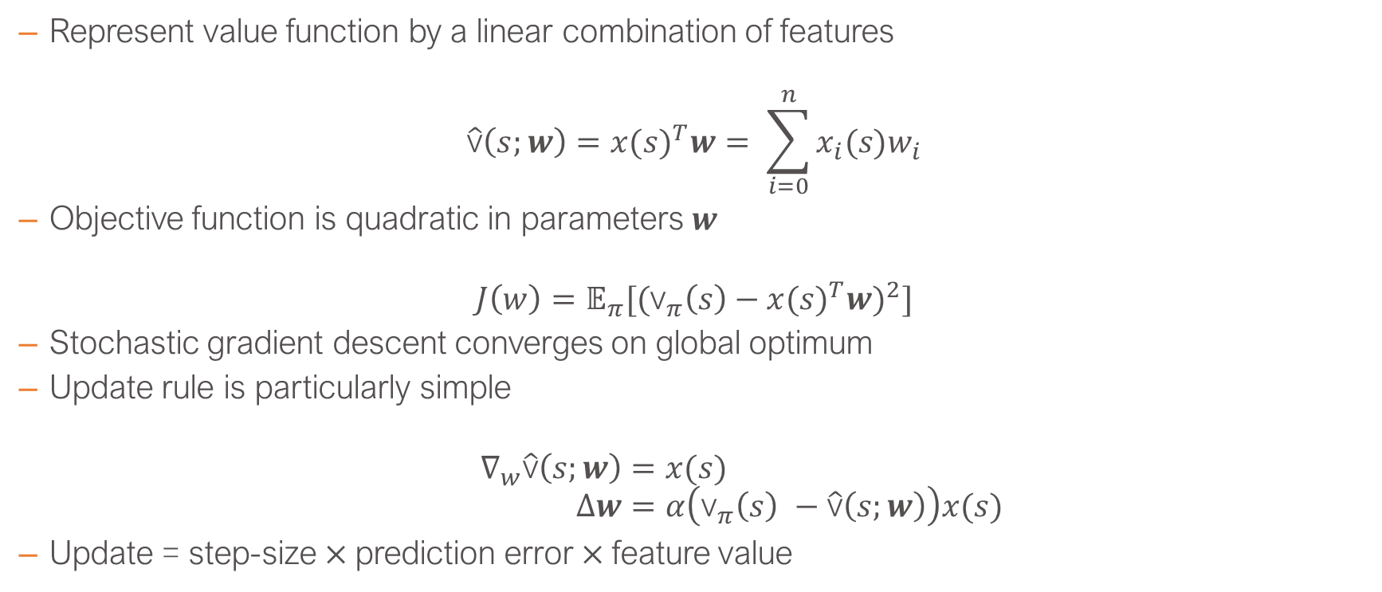
Linear Value Function Approximation
Represent value function by a linear combination of features
$$\hat{\text{v}}\left(s;w\right)={x(s)}^{T}w= \sum_{i=0}^{n}{x_{i}(s)w_{i}}$$
Objective function is quadratic in parameters $w$
$$J\left(w\right)=𝔼_{π}[{({\text{v}}_{π}\left(s\right)−{x(s)}^{T}w)}^{2}]$$
Stochastic gradient descent converges on global optimum
Update rule is particularly simple
$$∇_{w}\hat{\text{v}}\left(s;w\right)=x(s) \\ ∆w=α\left({\text{v}}_{π}\left(s\right) −\hat{\text{v}}\left(s;w\right)\right)x(s)$$
Update = step-size$×$prediction error$×$feature value
L. Brigato
Reinforcement Learning: Advanced RL

Slide 10
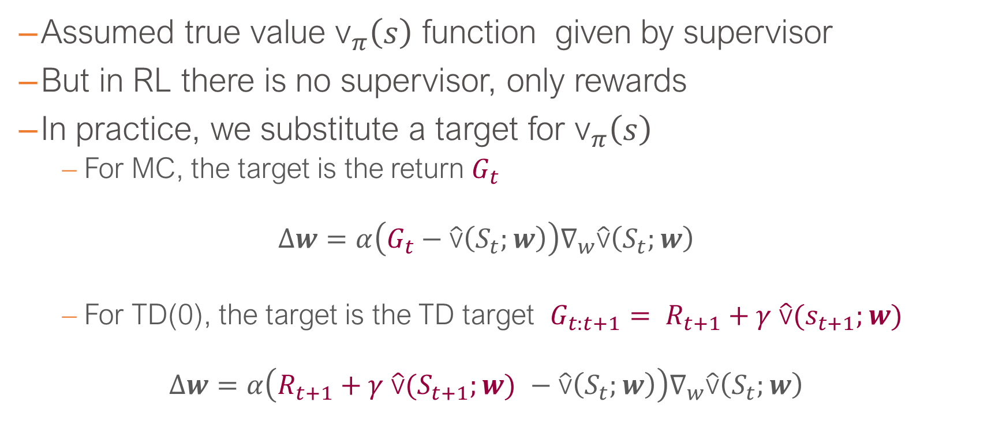
Incremental Prediction Algorithms
Assumed true value ${\text{v}}_{π}\left(s\right)$ function given by supervisor
But in RL there is no supervisor, only rewards
In practice, we substitute a target for ${\text{v}}_{π}\left(s\right)$
For MC, the target is the return $G_{t}$
$$∆w=α\left(G_{t}−\hat{\text{v}}\left(S_{t};w\right)\right)∇_{w}\hat{\text{v}}\left(S_{t};w\right)$$
For TD(0), the target is the TD target ${G_{t:t+1}= R}_{t+1}+γ$ $\hat{\text{v}}(s_{t+1};w)$
$$∆w=α\left(R_{t+1}+γ \hat{\text{v}}(S_{t+1};w\text{)} −\hat{\text{v}}\left(S_{t};w\right)\right)∇_{w}\hat{\text{v}}\left(S_{t};w\right)$$
L. Brigato
Reinforcement Learning: Advanced RL

Slide 11
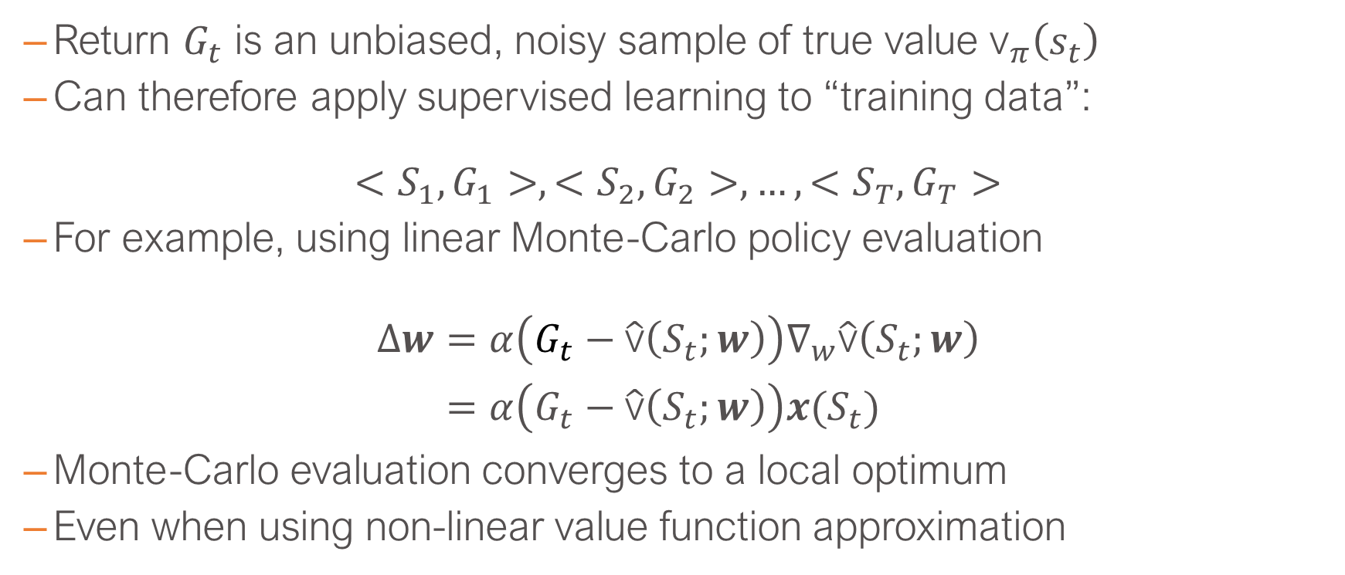
Monte-Carlo with Value Function Approximation (1/2)
Return $G_{t}$ is an unbiased, noisy sample of true value ${\text{v}}_{π}\left(s_{t}\right)$
Can therefore apply supervised learning to “training data”:
$$<S_{1},G_{1}>, <S_{2},G_{2}>,…,<S_{T},G_{T}>$$
For example, using linear Monte-Carlo policy evaluation
$$∆w=α\left(G_{t}−\hat{\text{v}}\left(S_{t};w\right)\right)∇_{w}\hat{\text{v}}\left(S_{t};w\right) \\ =α\left(G_{t}−\hat{\text{v}}\left(S_{t};w\right)\right)x(S_{t})$$
Monte-Carlo evaluation converges to a local optimum
Even when using non-linear value function approximation
L. Brigato
Reinforcement Learning: Advanced RL

Slide 12
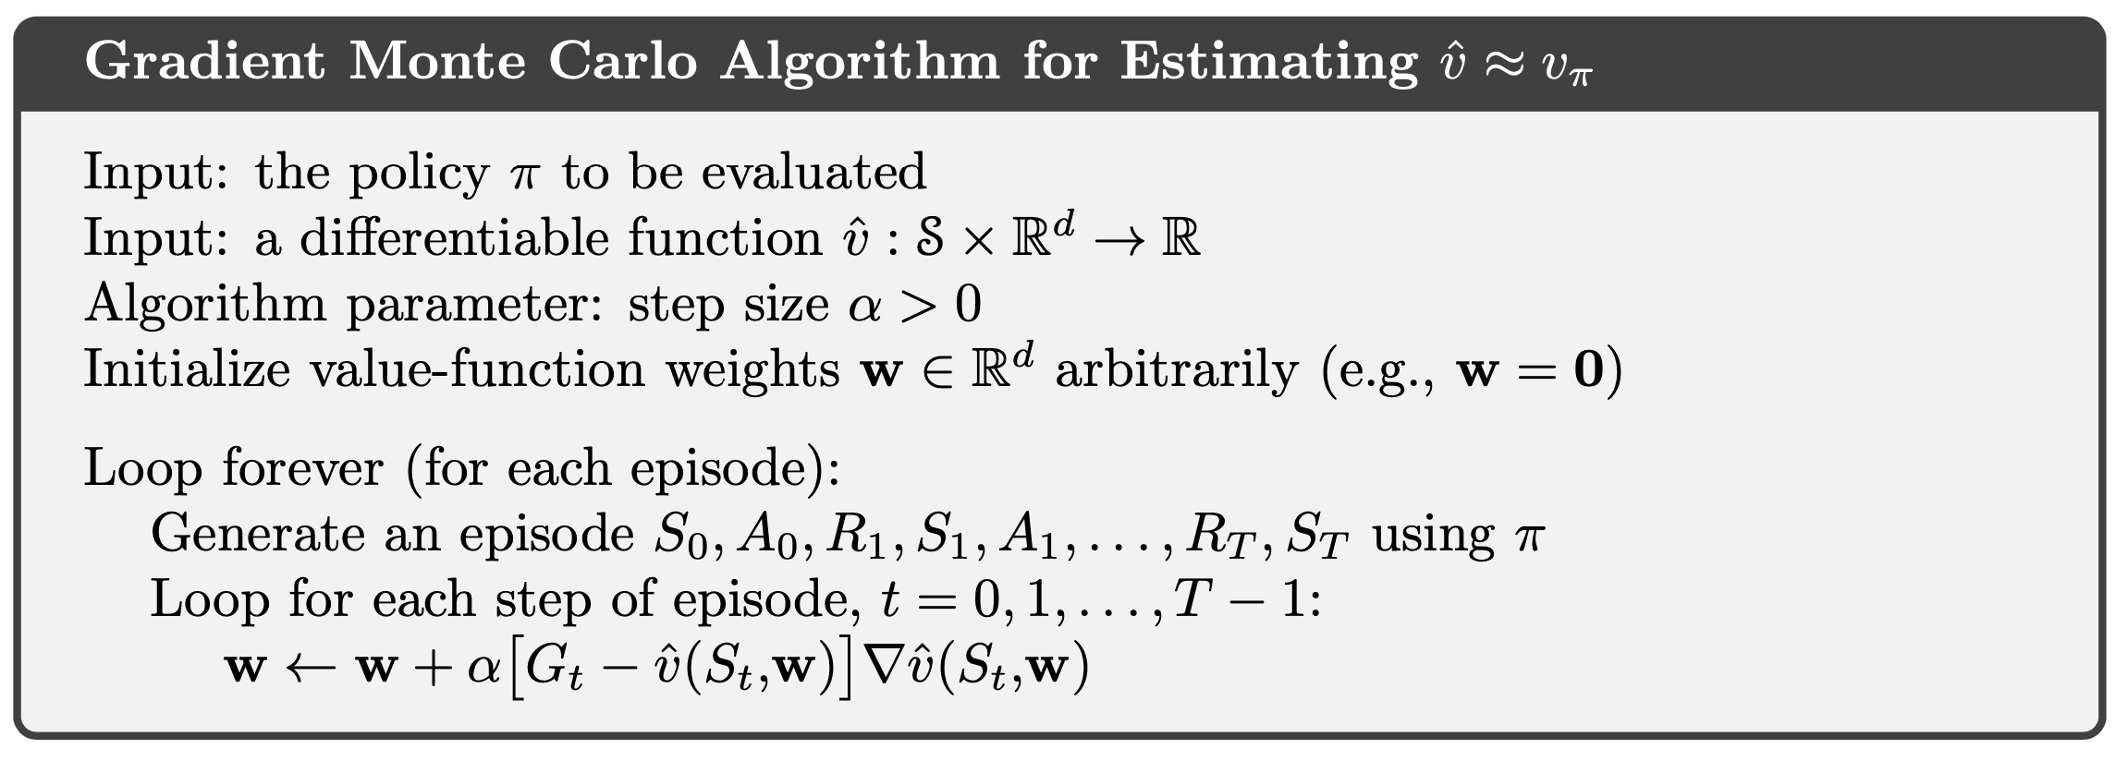
Monte-Carlo with Value Function Approximation (2/2)
[An Introduction to Reinforcement Learning, Sutton and Barto]
L. Brigato
Reinforcement Learning: Advanced RL

Slide 13
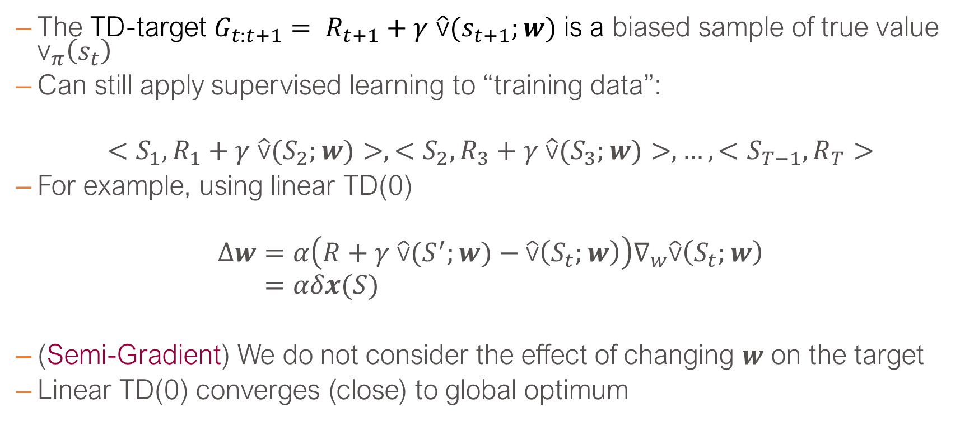
TD Learning with Value Function Approximation (1/2)
The TD-target ${G_{t:t+1}= R}_{t+1}+γ$ $\hat{\text{v}}(s_{t+1};w)$ is a biased sample of true value ${\text{v}}_{π}\left(s_{t}\right)$
Can still apply supervised learning to “training data”:
$$<S_{1},R_{1}+γ \hat{\text{v}}(S_{2};w)>, <S_{2},R_{3}+γ \hat{\text{v}}(S_{3};w)>,…,<S_{T−1},R_{T}>$$
For example, using linear TD(0)
$$∆w=α\left(R+γ \hat{\text{v}}(S^{′};w)−\hat{\text{v}}\left(S_{t};w\right)\right)∇_{w}\hat{\text{v}}\left(S_{t};w\right) \\ =αδx(S)$$
(Semi-Gradient) We do not consider the effect of changing $w$ on the target
Linear TD(0) converges (close) to global optimum
L. Brigato
Reinforcement Learning: Advanced RL

Slide 14
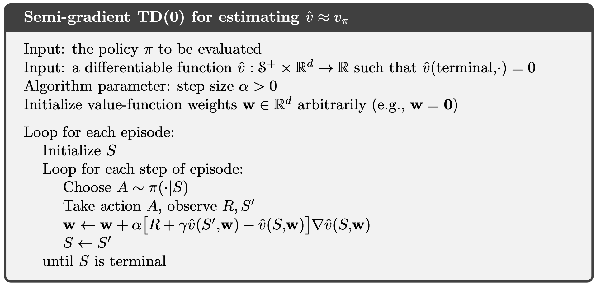
TD Learning with Value Function Approximation (2/2)
[An Introduction to Reinforcement Learning, Sutton and Barto]
L. Brigato
Reinforcement Learning: Advanced RL

Slide 15
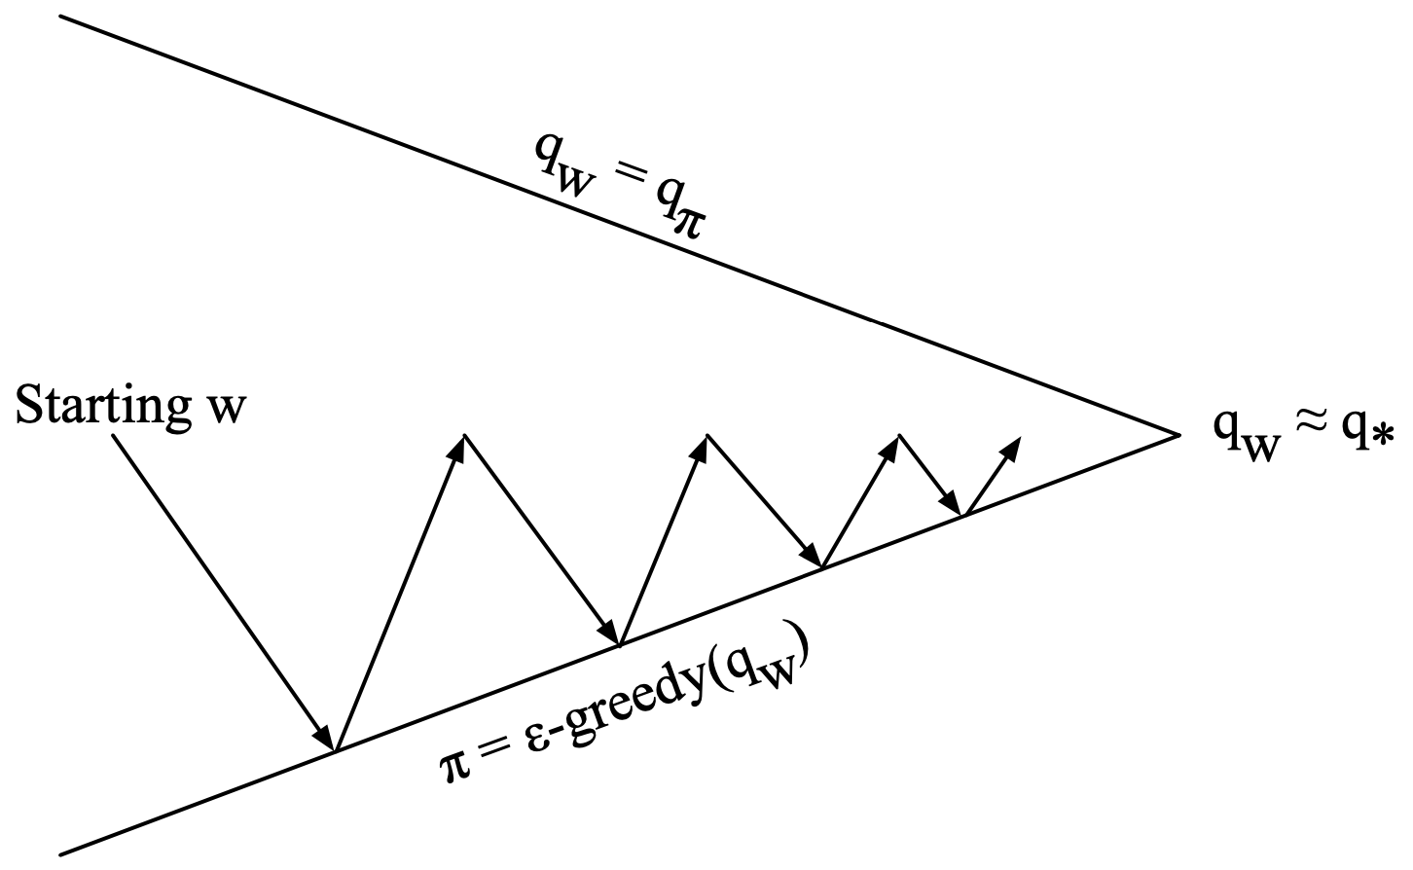
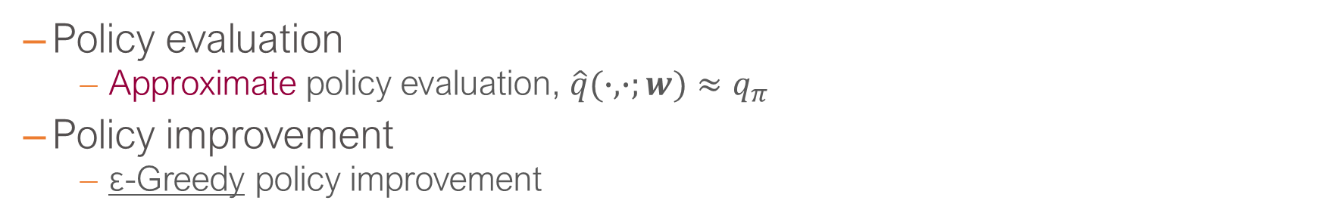
Control with Value Function Approximation
Policy evaluation
Approximate policy evaluation, $\hat{q}(∙,∙;w)≈q_{π}$
Policy improvement
ε-Greedy policy improvement
[David Silver, IRL, UCL 2015]
L. Brigato
Reinforcement Learning: Advanced RL

Slide 16
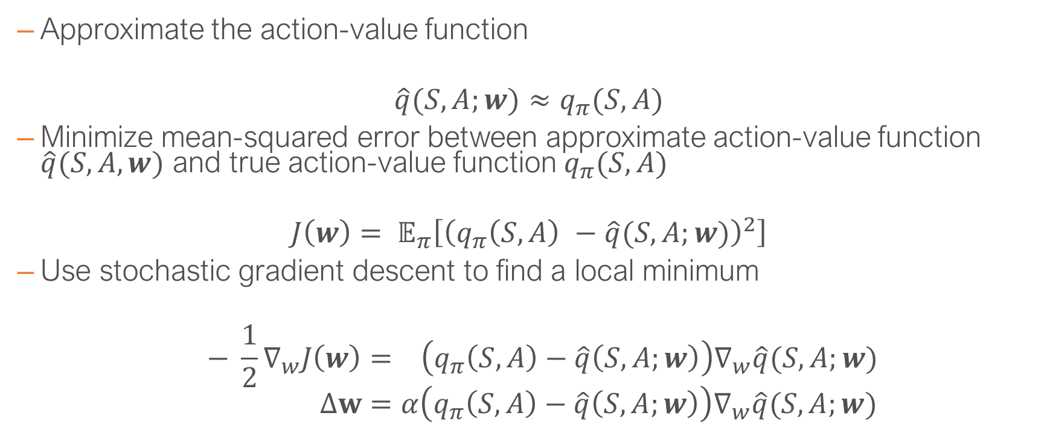
Action-Value Function Approximation
Approximate the action-value function
$$\hat{q}(S,A;w)≈q_{π}(S,A)$$
Minimize mean-squared error between approximate action-value function $\hat{q}(S,A,w)$ and true action-value function $q_{π}(S,A)$
$$J\left(w\right)= 𝔼_{π}\left[{\left(q_{π}\left(S,A\right) −\hat{q}(S,A;w)\right)}^{2}\right]$$
Use stochastic gradient descent to find a local minimum
$$− \frac{1}{2}∇_{w}J\left(w\right)= \left(q_{π}\left(S,A\right)−\hat{q}\left(S,A;w\right)\right)∇_{w}\hat{q}(S,A;w) \\ Δw=α\left(q_{π}\left(S,A\right)−\hat{q}\left(S,A;w\right)\right)∇_{w}\hat{q}(S,A;w)$$
L. Brigato
Reinforcement Learning: Advanced RL

Slide 17
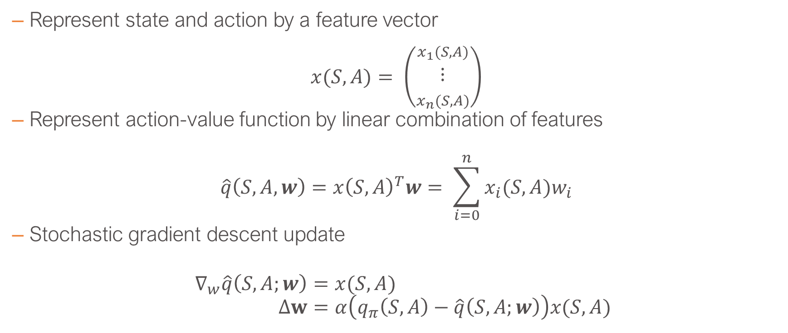
Linear Action-Value Function Approximation
Represent state and action by a feature vector
$x(S,A)= \left(\begin{matrix}x_{1}(S,A) \\ ⋮ \\ x_{n}(S,A)\end{matrix}\right)$
Represent action-value function by linear combination of features
$$\hat{q}\left(S,A,w\right)=x{\left(S,A\right)}^{T}w= \sum_{i=0}^{n}{x_{i}(S,A)w_{i}}$$
Stochastic gradient descent update
$$∇_{w}\hat{q}\left(S,A;w\right)=x(S,A) \\ Δw=α\left(q_{π}\left(S,A\right)−\hat{q}\left(S,A;w\right)\right)x(S,A)$$
L. Brigato
Reinforcement Learning: Advanced RL

Slide 18
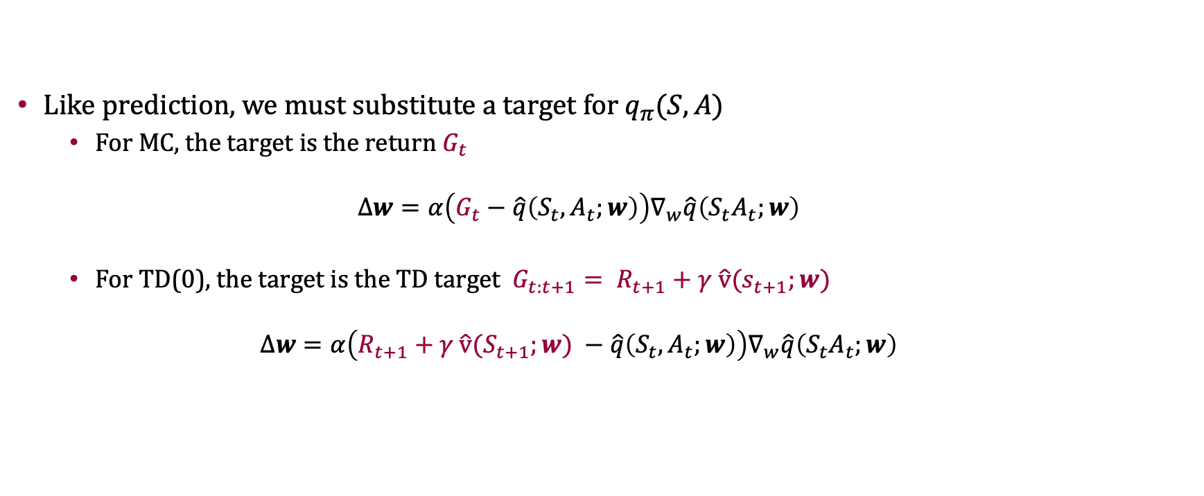
Incremental Control Algorithms
Like prediction, we must substitute a target for $q_{π}(S,A)$
For MC, the target is the return $G_{t}$
$$∆w=α\left(G_{t}−\hat{q}\left(S_{t},A_{t};w\right)\right)∇_{w}\hat{q}\left(S_{t}A_{t};w\right)$$
For TD(0), the target is the TD target ${G_{t:t+1}= R}_{t+1}+γ$ $\hat{\text{v}}(s_{t+1};w)$
$$∆w=α\left(R_{t+1}+γ \hat{\text{v}}(S_{t+1};w\text{)} −\hat{q}\left(S_{t},A_{t};w\right)\right)∇_{w}\hat{q}\left(S_{t}A_{t};w\right)$$
L. Brigato
Reinforcement Learning: Advanced RL

Slide 19
Policy Gradient

Slide 20
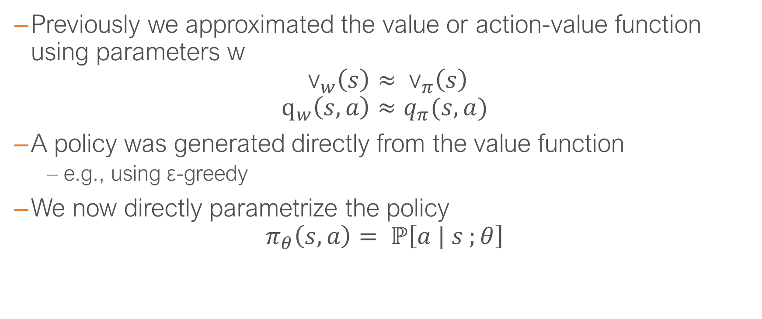
Policy-Based Reinforcement Learning
Previously we approximated the value or action-value function using parameters w
$${\text{v}}_{w}\left(s\right)≈ {\text{v}}_{π}\left(s\right) \\ {\text{q}}_{w}\left(s,a\right)≈q_{π}(s,a)$$
A policy was generated directly from the value function
e.g., using ε-greedy
We now directly parametrize the policy
$$π_{θ}\left(s,a\right)= ℙ\left[a | s ;θ\right]$$
L. Brigato
Reinforcement Learning: Advanced RL

Slide 21
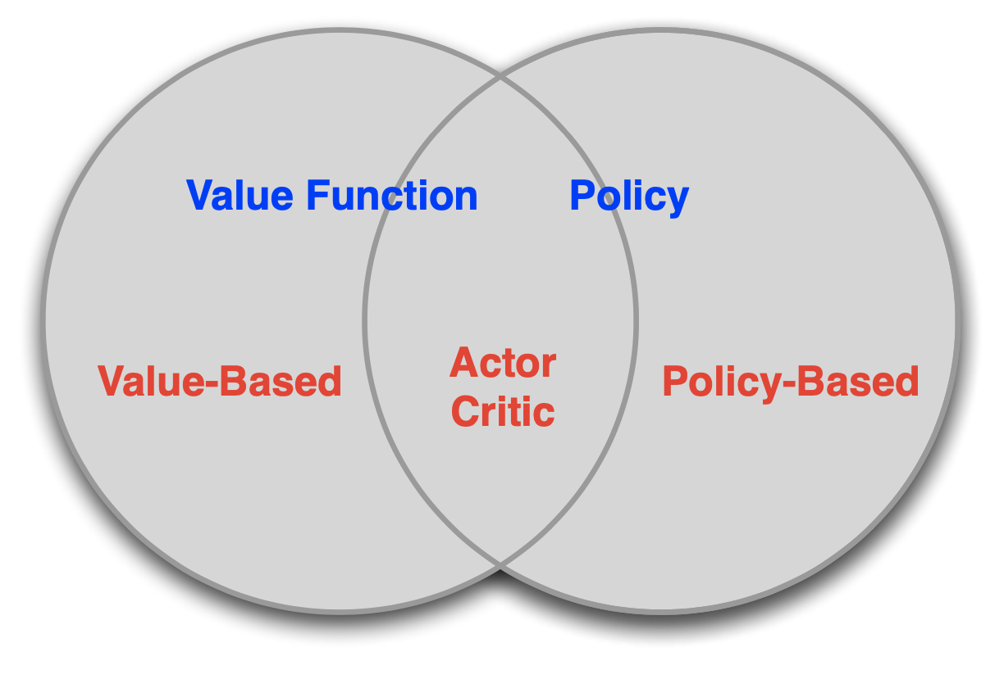
Value-Based and Policy-Based RL
Value Based
Learnt Value Function
Implicit policy (e.g., ε-greedy)
Policy Based
No Value Function
Learnt Policy
Actor-Critic
Learnt Value Function
Learnt Policy
[David Silver, IRL, UCL 2015]
L. Brigato
Reinforcement Learning: Advanced RL

Slide 22
Advantages of Policy-Based RL
Advantages:
Better convergence properties (in contrast to value function approximation that can oscillate in some configurations)
Effective in high-dimensional or continuous action spaces
Can learn stochastic policies
Disadvantages:
Typically converge to a local rather than global optimum
Evaluating a policy is typically inefficient and high variance
L. Brigato
Reinforcement Learning: Advanced RL

Slide 23
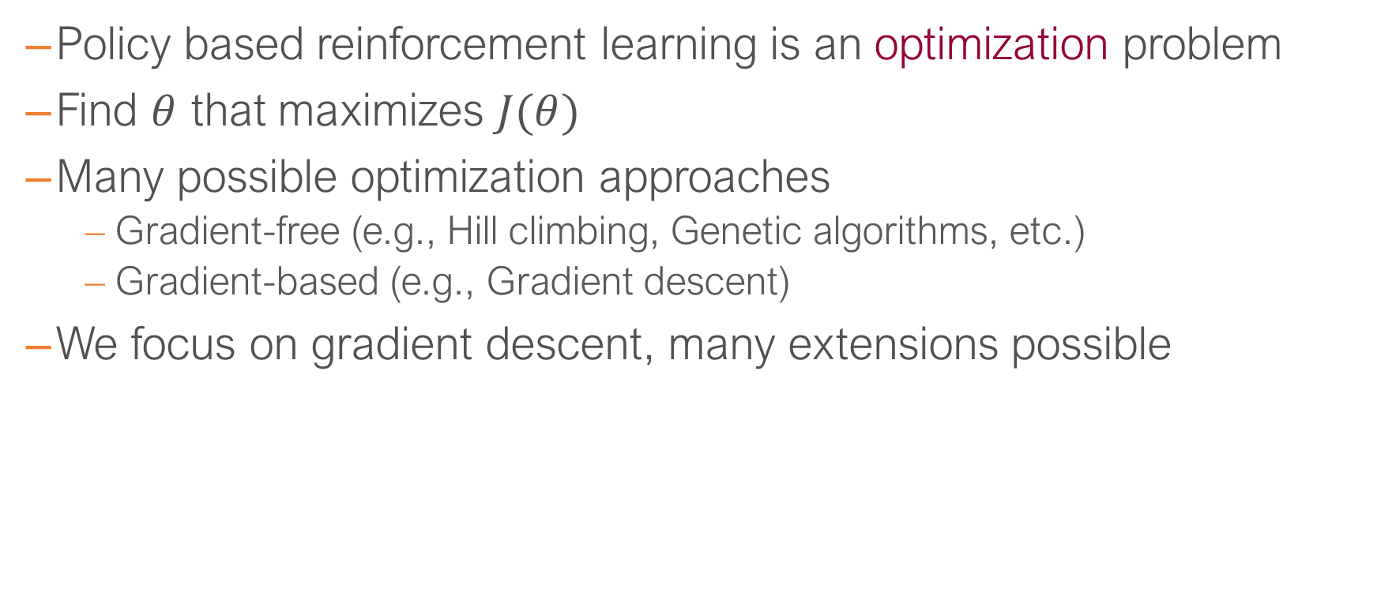
Policy Optimization
Policy based reinforcement learning is an optimization problem
Find $θ$ that maximizes $J(θ)$
Many possible optimization approaches
Gradient-free (e.g., Hill climbing, Genetic algorithms, etc.)
Gradient-based (e.g., Gradient descent)
We focus on gradient descent, many extensions possible
L. Brigato
Reinforcement Learning: Advanced RL

Slide 24

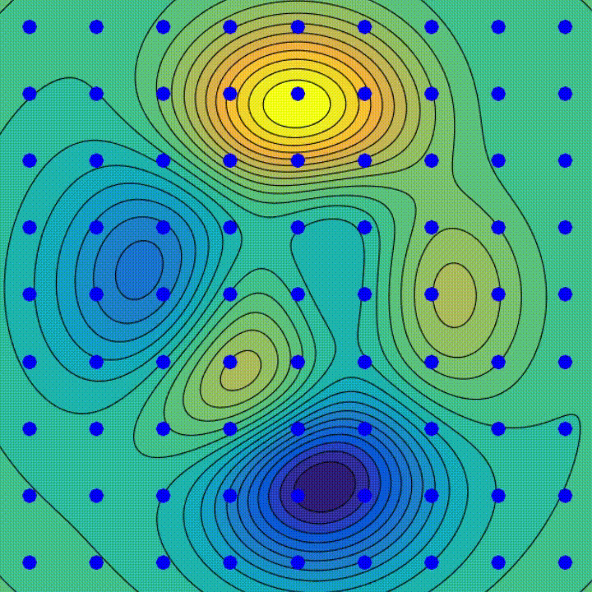
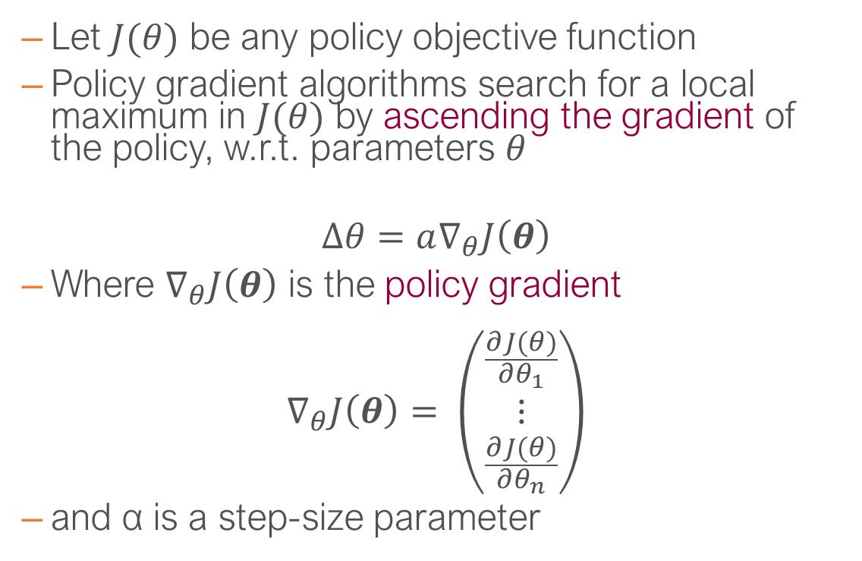
Policy Gradient
Let $J(θ)$ be any policy objective function
Policy gradient algorithms search for a local maximum in $J(θ)$ by ascending the gradient of the policy, w.r.t. parameters $θ$
$$∆θ=a∇_{θ}J\left(θ\right)$$
Where $∇_{θ}J\left(θ\right)$ is the policy gradient
$$∇_{θ}J\left(θ\right)= \left(\begin{matrix}\frac{∂J(θ)}{∂θ_{1}} \\ ⋮ \\ \frac{∂J(θ)}{∂θ_{n}}\end{matrix}\right)$$
and α is a step-size parameter
L. Brigato
Reinforcement Learning: Advanced RL

Slide 25
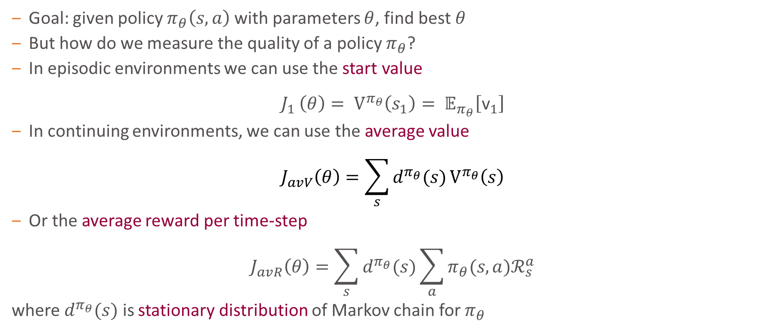
Policy Objective Functions
Goal: given policy $π_{θ}\left(s,a\right)$with parameters $θ$, find best $θ$
But how do we measure the quality of a policy $π_{θ}$?
In episodic environments we can use the start value
$$J_{1 }\left(θ\right)= V^{π_{θ}}\left(s_{1}\right)= 𝔼_{π_{θ}}\left[{\text{v}}_{1}\right]$$
In continuing environments, we can use the average value
$$J_{avV}\left(θ\right)=\sum_{s}{d^{π_{θ}}(s)}V^{π_{θ}}\left(s\right)$$
Or the average reward per time-step
$$J_{avR}\left(θ\right)=\sum_{s}{d^{π_{θ}}(s)}\sum_{a}{π_{θ}(s,a)ℛ_{s}^{a}}$$
where $d^{π_{θ}}(s)$ is stationary distribution of Markov chain for $π_{θ}$
L. Brigato
Reinforcement Learning: Advanced RL

Slide 26
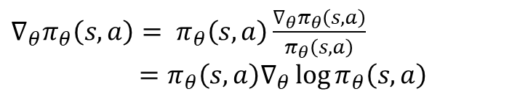
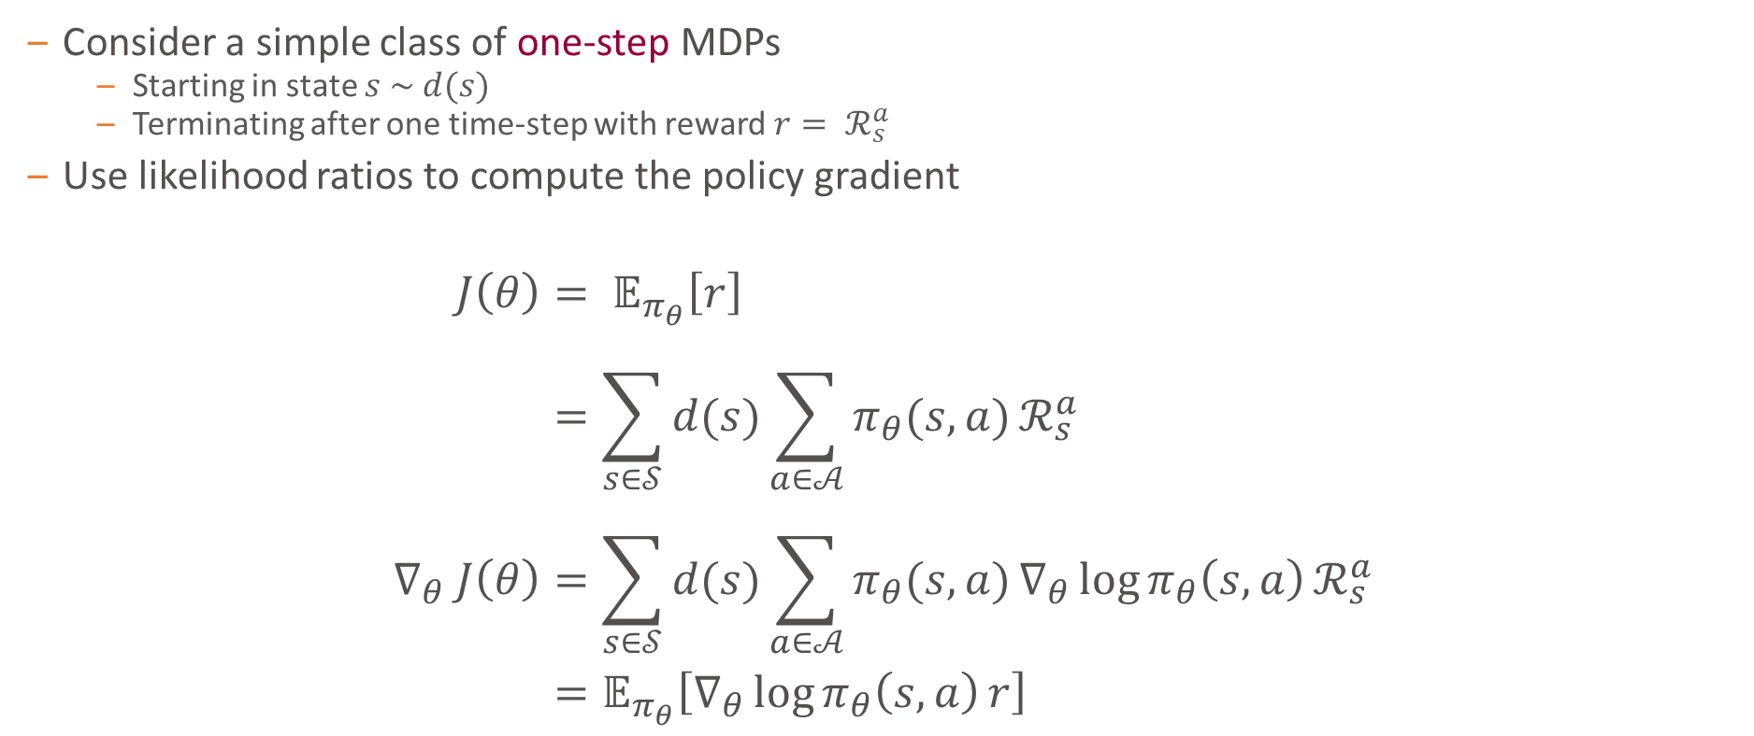
One-Step MDPs
Consider a simple class of one-step MDPs
Starting in state $s \sim d(s)$
Terminating after one time-step with reward $r= ℛ_{s}^{a}$
Use likelihood ratios to compute the policy gradient
$$J\left(θ\right)= 𝔼_{π_{θ}}\left[r\right] \\ =\sum_{s∈𝒮}{d(s)}\sum_{a∈𝒜}{π_{θ}(s,a)}ℛ_{s}^{a} \\ ∇_{θ} J\left(θ\right)=\sum_{s∈𝒮}{d(s)}\sum_{a∈𝒜}{π_{θ}(s,a)}∇_{θ}\log{π_{θ}\left(s,a\right)}ℛ_{s}^{a} \\ =𝔼_{π_{θ}}\left[∇_{θ}\log{π_{θ}\left(s,a\right)}r\right]$$
$∇_{θ}π_{θ}\left(s,a\right)= π_{θ}\left(s,a\right)\frac{∇_{θ}π_{θ}\left(s,a\right)}{π_{θ}\left(s,a\right)}$
$$=π_{θ}\left(s,a\right)∇_{θ}\log{π_{θ}\left(s,a\right)}$$
L. Brigato
Reinforcement Learning: Advanced RL

Slide 27
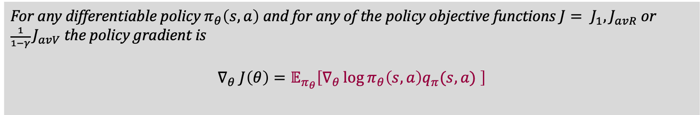
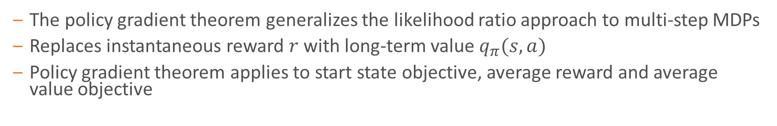
Policy Gradient Theorem
The policy gradient theorem generalizes the likelihood ratio approach to multi-step MDPs
Replaces instantaneous reward $r$ with long-term value $q_{π}(s,a)$
Policy gradient theorem applies to start state objective, average reward and average value objective
Theorem (Policy Gradient)
For any differentiable policy $π_{θ}\left(s,a\right)$ and for any of the policy objective functions $J= J_{1}, J_{avR}$ or ${\frac{1}{1−γ} J}_{avV}$ the policy gradient is
$$∇_{θ} J\left(θ\right)=𝔼_{π_{θ}}\left[∇_{θ}\log{π_{θ}\left(s,a\right)q_{π}(s,a) }\right]$$
L. Brigato
Reinforcement Learning: Advanced RL

Slide 28
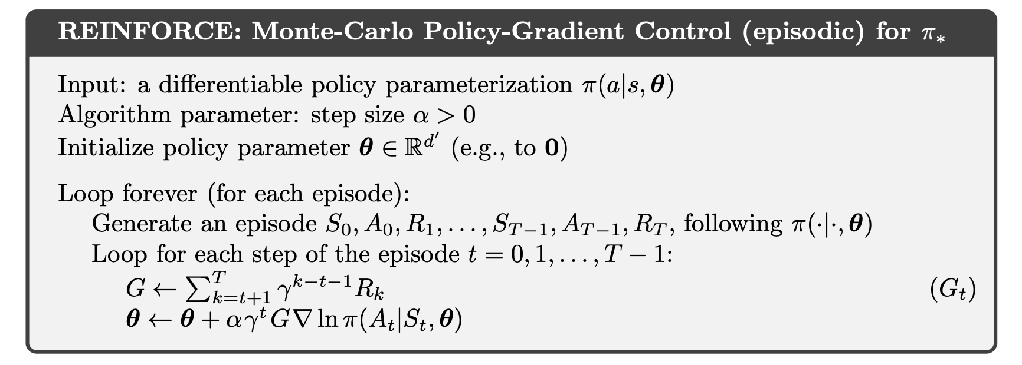
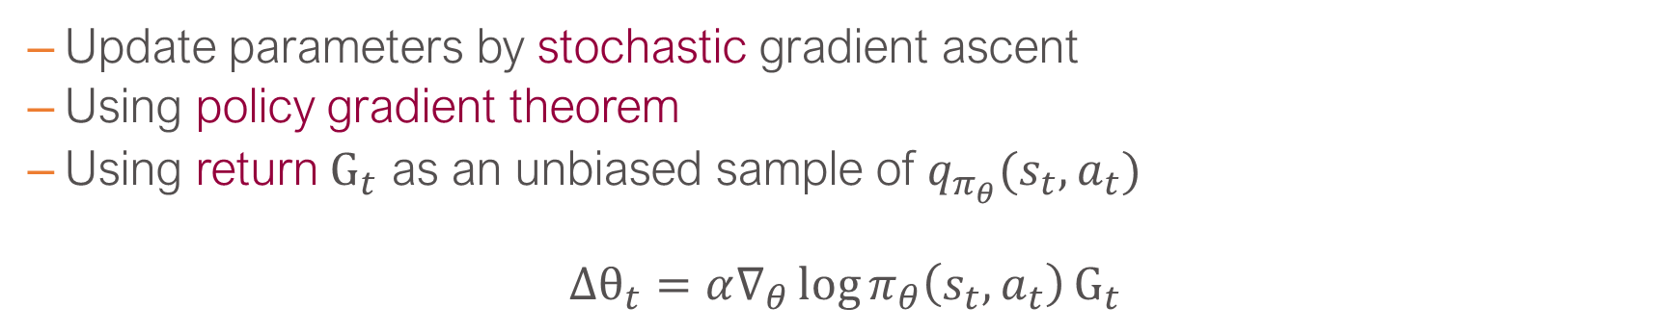
Monte-Carlo Policy Gradient (REINFORCE)
Update parameters by stochastic gradient ascent
Using policy gradient theorem
Using return ${\text{G}}_{t}$ as an unbiased sample of $q_{π_{θ}}(s_{t},a_{t})$
$${Δθ}_{t}=α∇_{θ}\log{π_{θ}\left(s_{t},a_{t}\right)}{\text{G}}_{t}$$
[An Introduction to Reinforcement Learning, Sutton and Barto]
L. Brigato
Reinforcement Learning: Advanced RL

Slide 29
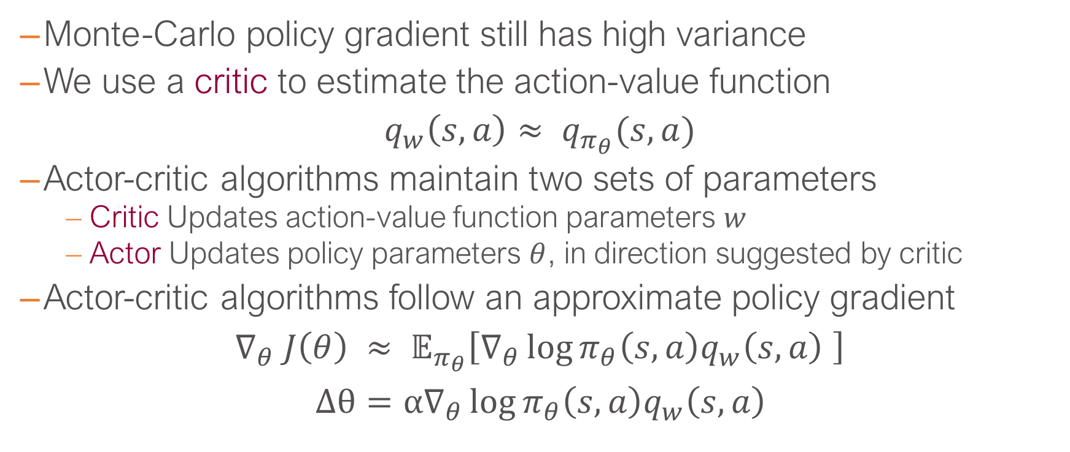
Reducing Variance Using a Critic
Monte-Carlo policy gradient still has high variance
We use a critic to estimate the action-value function
$q_{w}\left(s,a\right)≈ q_{π_{θ}}(s,a)$
Actor-critic algorithms maintain two sets of parameters
Critic Updates action-value function parameters $w$
Actor Updates policy parameters $θ$, in direction suggested by critic
Actor-critic algorithms follow an approximate policy gradient
$$∇_{θ} J\left(θ\right) ≈ 𝔼_{π_{θ}}\left[∇_{θ}\log{π_{θ}\left(s,a\right)q_{w}\left(s,a\right) }\right] \\ Δθ=α∇_{θ}\log{π_{θ}\left(s,a\right)q_{w}\left(s,a\right) }$$
L. Brigato
Reinforcement Learning: Advanced RL

Slide 30
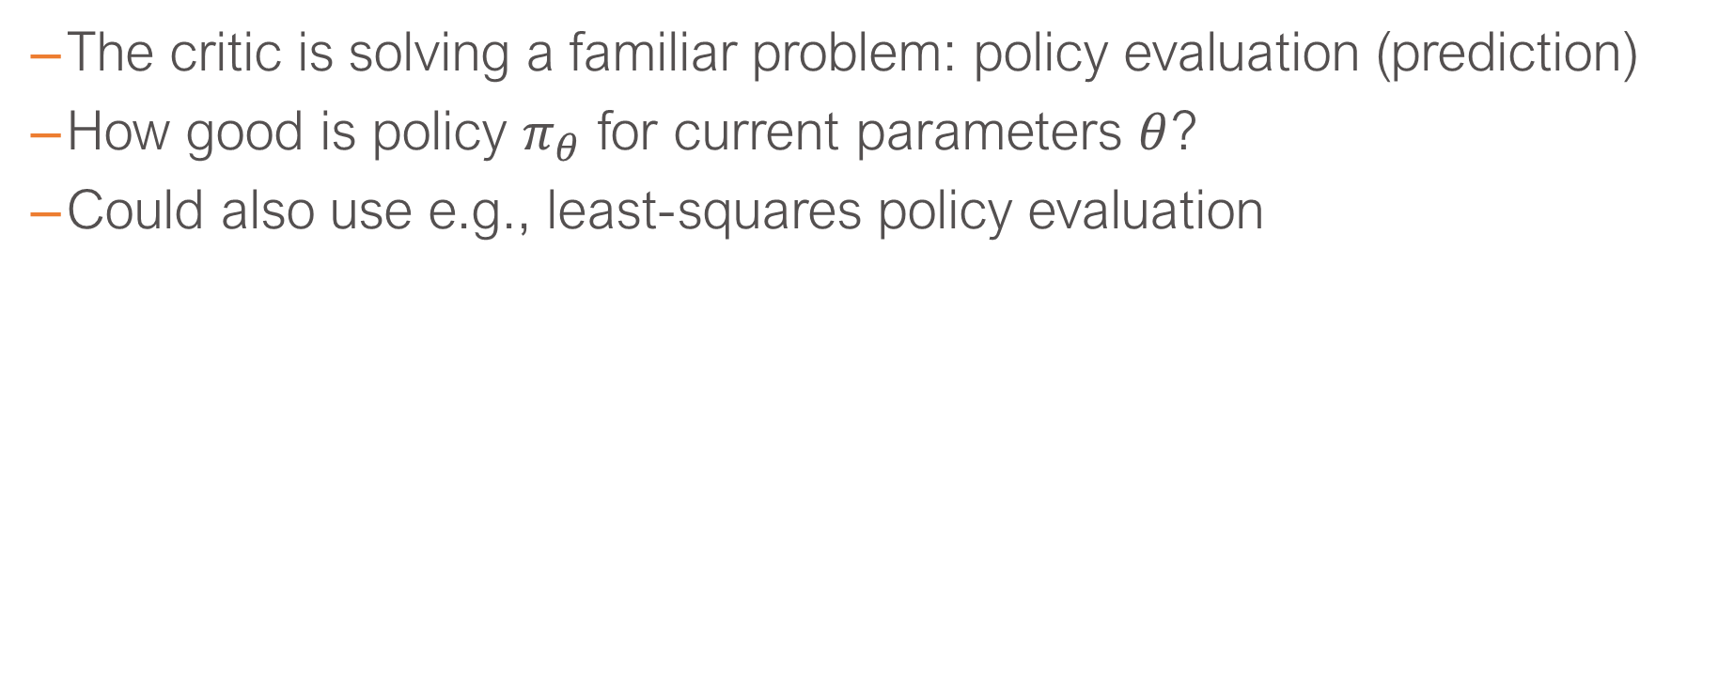
Estimating the Action-Value Function
The critic is solving a familiar problem: policy evaluation (prediction)
How good is policy $π_{θ}$ for current parameters $θ$?
Could also use e.g., least-squares policy evaluation
L. Brigato
Reinforcement Learning: Advanced RL

Slide 31
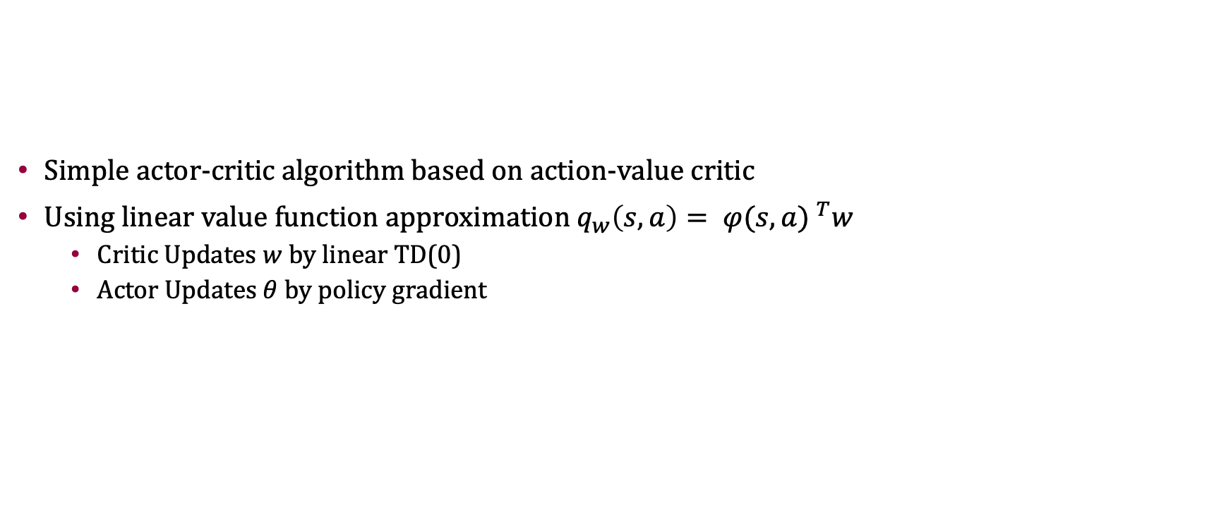
Action-Value Actor-Critic (1/2)
Simple actor-critic algorithm based on action-value critic
Using linear value function approximation $q_{w}\left(s,a\right)= {φ(s,a) }^{T}w$
Critic Updates $w$ by linear TD(0)
Actor Updates $θ$ by policy gradient
L. Brigato
Reinforcement Learning: Advanced RL

Slide 32
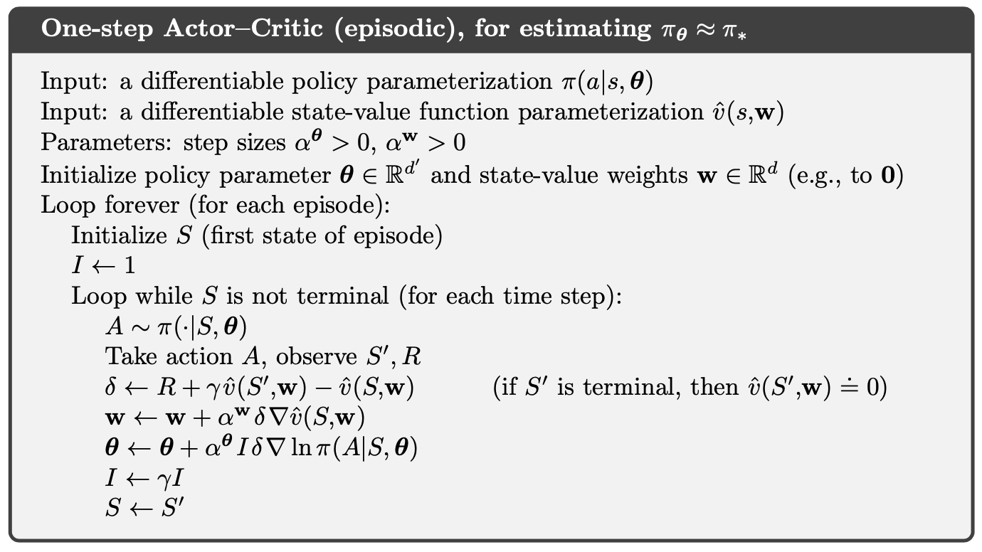
Action-Value Actor-Critic (2/2)
[An Introduction to Reinforcement Learning, Sutton and Barto]
L. Brigato
Reinforcement Learning: Advanced RL

Slide 33
Deep Reinforcement Learning

Slide 34
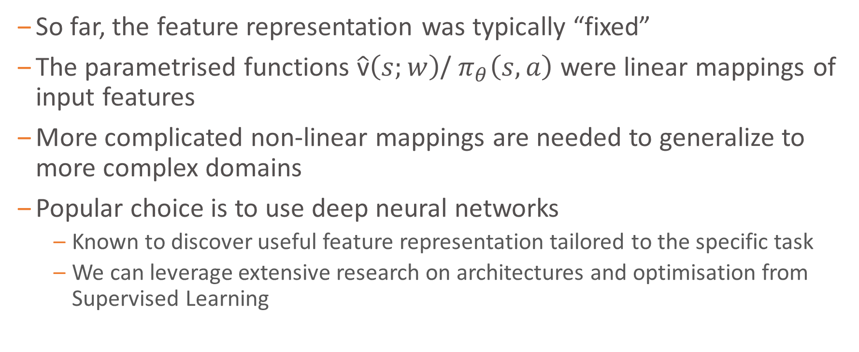
Approximation with Deep Networks
So far, the feature representation was typically “fixed”
The parametrised functions $\hat{\text{v}}\left(s;w\right)$/ $π_{θ}\left(s,a\right)$ were linear mappings of input features
More complicated non-linear mappings are needed to generalize to more complex domains
Popular choice is to use deep neural networks
Known to discover useful feature representation tailored to the specific task
We can leverage extensive research on architectures and optimisation from Supervised Learning
L. Brigato
Reinforcement Learning: Advanced RL

Slide 35
Batch Reinforcement Learning
Gradient descent is simple and appealing
But it is not sample efficient
Batch methods seek to find the best fitting value function
Given the agent’s experience (“training data”)
L. Brigato
Reinforcement Learning: Advanced RL

Slide 36
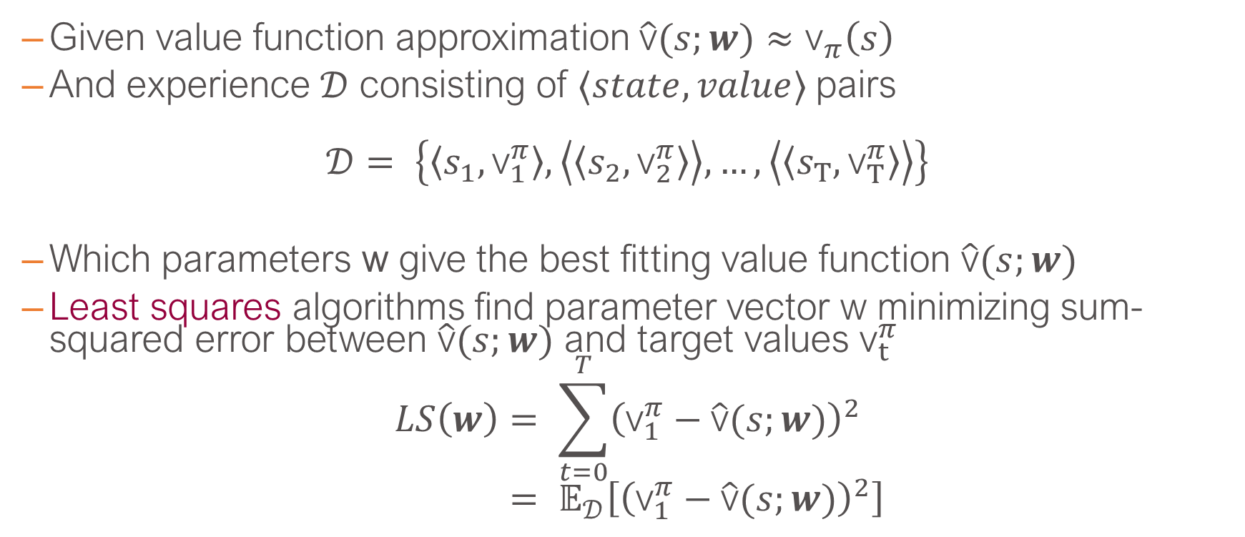
Least Squares Prediction
Given value function approximation $\hat{\text{v}}(s;w)≈{\text{v}}_{π}\left(s\right)$
And experience $𝒟$ consisting of $⟨state,value⟩$pairs
$$𝒟= \left\{\left\langle s_{1},{\text{v}}_{1}^{π}\right\rangle ,\left\langle \left\langle s_{2},{\text{v}}_{2}^{π}\right\rangle \right\rangle ,…,\left\langle \left\langle s_{Τ},{\text{v}}_{Τ}^{π}\right\rangle \right\rangle \right\}$$
Which parameters w give the best fitting value function $\hat{\text{v}}(s;w)$
Least squares algorithms find parameter vector w minimizing sum-squared error between $\hat{\text{v}}(s;w)$ and target values ${\text{v}}_{t}^{π}$
$$LS\left(w\right)= \sum_{t=0}^{T}{{\left({\text{v}}_{1}^{π}−\hat{\text{v}}(s;w)\right)}^{2}} \\ = 𝔼_{𝒟}\left[{\left({\text{v}}_{1}^{π}−\hat{\text{v}}(s;w)\right)}^{2}\right]$$
L. Brigato
Reinforcement Learning: Advanced RL

Slide 37
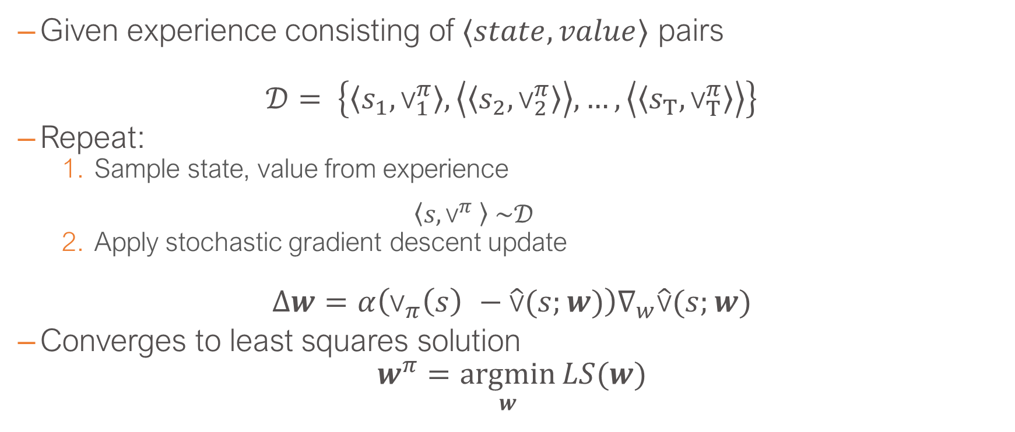
Stochastic Gradient Descent with Experience Replay
Given experience consisting of $⟨state,value⟩$ pairs
$𝒟= \left\{\left\langle s_{1},{\text{v}}_{1}^{π}\right\rangle ,\left\langle \left\langle s_{2},{\text{v}}_{2}^{π}\right\rangle \right\rangle ,…,\left\langle \left\langle s_{Τ},{\text{v}}_{Τ}^{π}\right\rangle \right\rangle \right\}$
Repeat:
Sample state, value from experience $\left\langle s,{\text{v}}^{π} \right\rangle \sim 𝒟$
Apply stochastic gradient descent update
$$∆w=α\left({\text{v}}_{π}\left(s\right) −\hat{\text{v}}(s;w)\right)∇_{w}\hat{\text{v}}(s;w)$$
Converges to least squares solution
$$w^{π}=\underset{w}{argmin}{LS(w)}$$
L. Brigato
Reinforcement Learning: Advanced RL

Slide 38
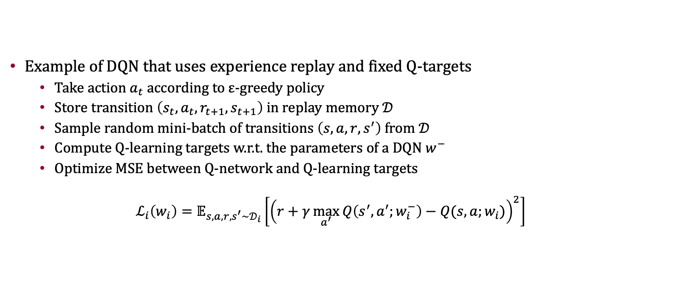
Experience Replay in Deep Q-Networks (DQN)
Example of DQN that uses experience replay and fixed Q-targets
Take action $a_{t}$ according to ε-greedy policy
Store transition $\left(s_{t},a_{t},r_{t+1},s_{t+1}\right)$ in replay memory $𝒟$
Sample random mini-batch of transitions $\left(s,a,r,s^{′}\right)$ from $𝒟$
Compute Q-learning targets w.r.t. the parameters of a DQN $w^{−}$
Optimize MSE between Q-network and Q-learning targets
$$ℒ_{i}\left(w_{i}\right)=𝔼_{s,a,r,s^{′}\sim 𝒟_{i}}\left[{\left(r+γ\max_{a^{′}}{Q\left(s^{′},a^{′};w_{i}^{−}\right)−Q(s,a;w_{i})}\right)}^{2}\right]$$
L. Brigato
Reinforcement Learning: Advanced RL

Slide 39
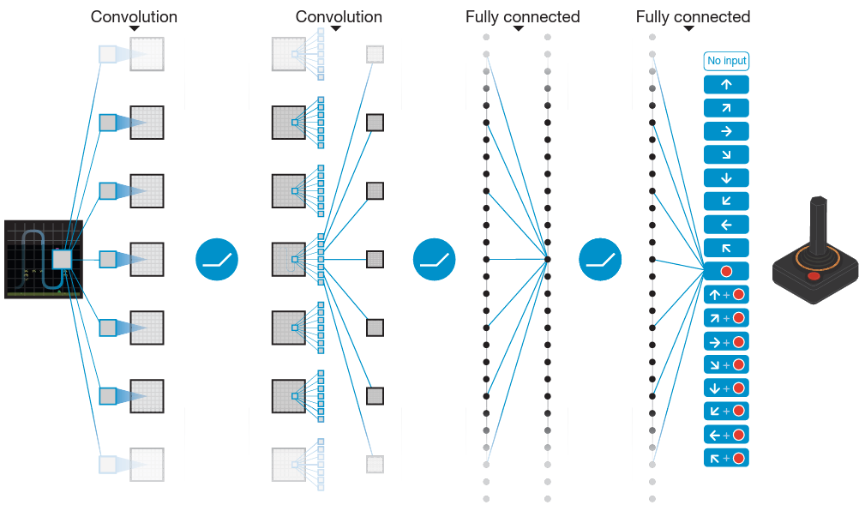
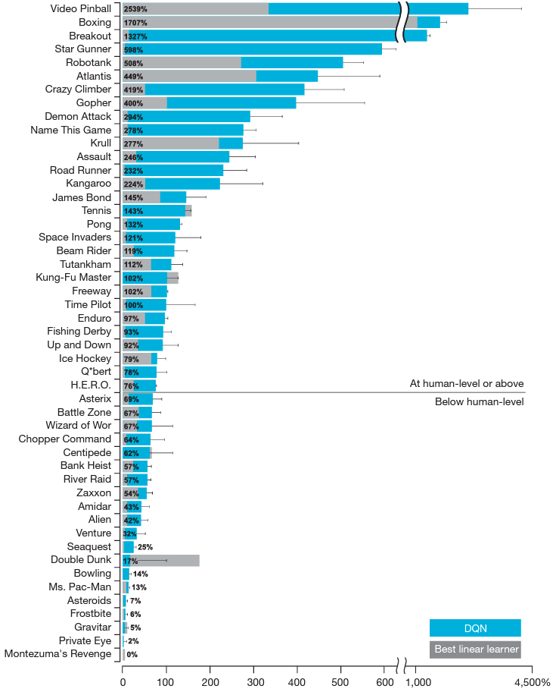
DQN in Atari
[doi:10.1038/nature14236]
L. Brigato
Reinforcement Learning: Advanced RL

Slide 40
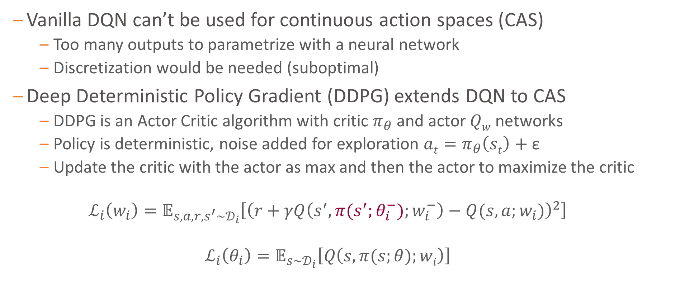
Continuous Action Spaces
Vanilla DQN can’t be used for continuous action spaces (CAS)
Too many outputs to parametrize with a neural network
Discretization would be needed (suboptimal)
Deep Deterministic Policy Gradient (DDPG) extends DQN to CAS
DDPG is an Actor Critic algorithm with critic $π_{θ}$and actor $Qw$ networks
Policy is deterministic, noise added for exploration ${at=π}_{θ}\left(st\right)+$ε
Update the critic with the actor as max and then the actor to maximize the critic
$$ℒ_{i}\left(w_{i}\right)=𝔼_{s,a,r,s^{′}\sim 𝒟_{i}}\left[{\left(r+γQ\left(s^{′},{π(s}^{′};θ_{i}^{−});w_{i}^{−}\right)−Q(s,a;w_{i})\right)}^{2}\right]$$
$$ℒ_{i}\left(θ_{i}\right)=𝔼_{s\sim 𝒟_{i}}\left[Q\left(s,π(s;θ);wi\right)\right]$$
L. Brigato
Reinforcement Learning: Advanced RL

Slide 41
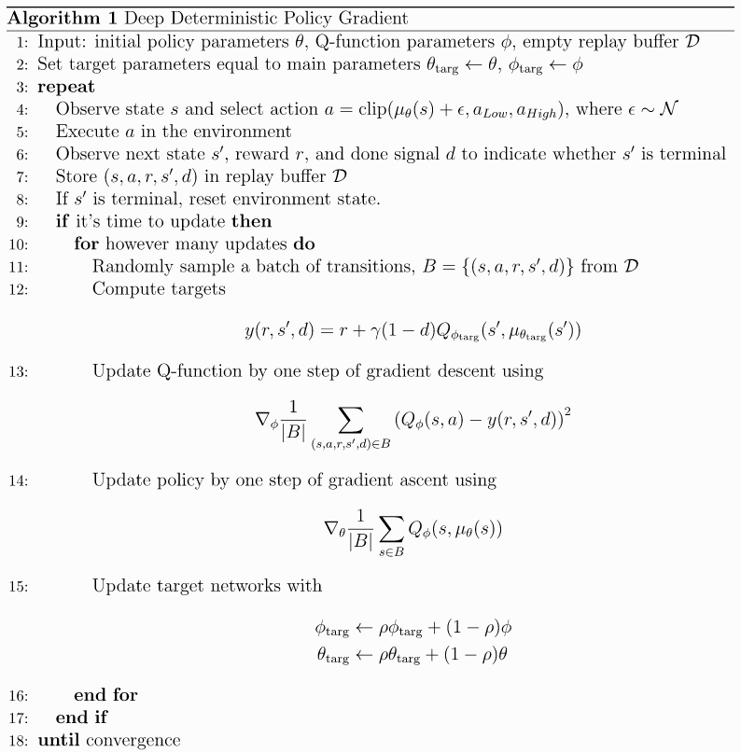
DDPG
L. Brigato
Reinforcement Learning: Advanced RL

Slide 42
Issues in Exploration
Deep RL usually deals with:
Large state spaces
Function approximation
Sometimes sparse / long-term reward
Simple algorithms work OK (e.g., ε-greedy)
Need for more general algorithms
L. Brigato
Reinforcement Learning: Advanced RL
42
UBERN: L. Brigato

Slide 43
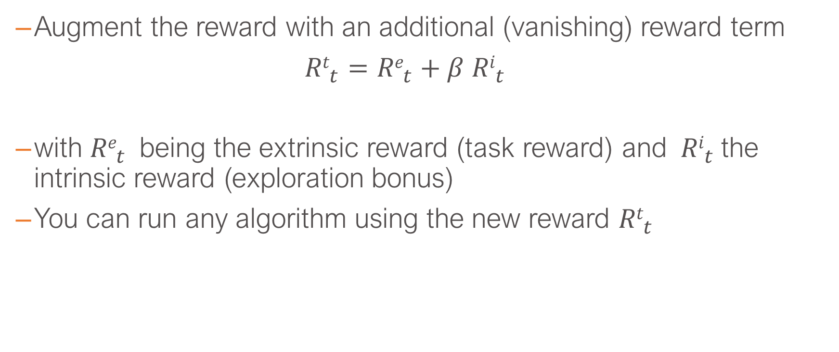
Intrinsic Reward
Augment the reward with an additional (vanishing) reward term
${Rt}_{t}={Re}_{t}+β{ Ri}_{t}$
with ${Re}_{t}$being the extrinsic reward (task reward) and ${ Ri}_{t}$the intrinsic reward (exploration bonus)
You can run any algorithm using the new reward ${Rt}_{t}$
L. Brigato
Reinforcement Learning: Advanced RL
43
UBERN: L. Brigato

Slide 44
Intrinsic Reward
How can we define the intrinsic reward bonus? Several options (on-going research):
Discover new states
Improve knowledge
Improve controllability
…
Two of many approaches:
Count-based bonus
Prediction-based bonus
L. Brigato
Reinforcement Learning: Advanced RL
44
UBERN: L. Brigato

Slide 45
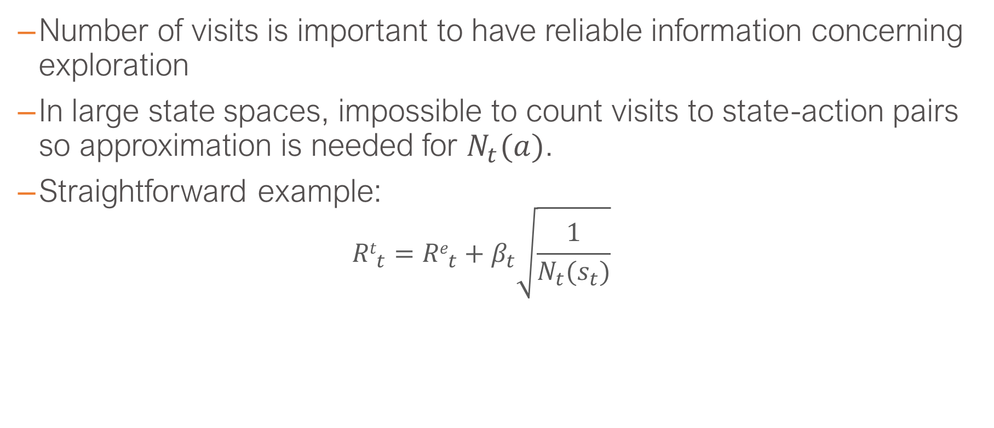
Count-based
Number of visits is important to have reliable information concerning exploration
In large state spaces, impossible to count visits to state-action pairs so approximation is needed for $N_{t}(a)$.
Straightforward example:
$${Rt}_{t}={Re}_{t}+β_{t}\sqrt{\frac{1}{N_{t}(s_{t})}}$$
L. Brigato
Reinforcement Learning: Advanced RL
45
UBERN: L. Brigato

Slide 46


Count-based
[Unifying Count-Based Exploration and Intrinsic Motivation, Bellemare et al.]
L. Brigato
Reinforcement Learning: Advanced RL
46
UBERN: L. Brigato

Slide 47
Count-based
Example: use locality-sensitive hashing (LSH) to implement counting
Counting is performed into latent space rather than input (pixel) space
The state is compressed into a code such that its count can be increased
The image-encoding is obtained by using autoencoders
The count is made on discrete hashed-states (LSH)
Note: There is no guarantee that the reconstruction loss will capture the important things that make two states to be similar or not policy wise
L. Brigato
Reinforcement Learning: Advanced RL
47
UBERN: L. Brigato

Slide 48


Count-based
[#Exploration: A Study of Count-Based Exploration for Deep Reinforcement Learning, Tang et al.]
L. Brigato
Reinforcement Learning: Advanced RL
48
UBERN: L. Brigato

Slide 49
Prediction-based
Computational Curiosity idea: Let’s explore to improve skills
Look for novelty and surprises
Execute behaviors that reduce uncertainty on how the world works looking for novelty and surprises
It implies a world-model (model-based RL)
predict what is going to happen given what I am expecting to happen
L. Brigato
Reinforcement Learning: Advanced RL
49
UBERN: L. Brigato

Slide 50

Prediction-based
Example: Add as bonus the error in the prediction. Bigger error in prediction means less knowledge of the next state (= increased novelty)
Given an encoding of the state $φ(s)$ the agent learns a prediction model:
$f: (φ\left(s\right), at)$ -> $φ\left(st+1\right)$
Use prediction error $et$ (properly normalized and scaled) as exploration bonus ${ Ri}_{t}$:
${ Ri}_{t}\text{∝} et=||φ\left(st+1\right)$ - $f\left(φ\left(s\right),at\right)||2$
L. Brigato
Reinforcement Learning: Advanced RL
50
UBERN: L. Brigato

Slide 51
Prediction-based
Problem with previous example: Predicting every possible change in the transitions is difficult and may not be necessary
E.g., predictions that do not depend on agent actions
Proof-of-fact examples:
Agent can’t predict TV schedule, so it gets stuck behind the TV
Agent can’t predict the random movements of leafes due to wind, so it gets stuck looking at trees
…
L. Brigato
Reinforcement Learning: Advanced RL
51
UBERN: L. Brigato

Slide 52

Prediction-based
Predict changes that depend on agent’s actions, ignore the rest
The features of the state depend on the inverse model
[Curiosity-driven Exploration by Self-supervised Prediction, Pathak et al.]
L. Brigato
Reinforcement Learning: Advanced RL
52
UBERN: L. Brigato

Slide 53


Prediction-based
Test: As TV is not controllable by the agent, the model will be blind to the features of the TV
[Curiosity-driven Exploration by Self-supervised Prediction, Pathak et al.]
L. Brigato
Reinforcement Learning: Advanced RL
53
UBERN: L. Brigato

Slide 54

On-Policy Stochastic Training
DDPG is an off-policy method that does not explore by itself
Just addition of random noise to deterministic action
Soft actor Critic (SAC) embeds entropy into objective function
$$𝔼_{π_{θ}}\left[r+α H(π_{θ}\left(s\right)) \right]$$
SAC updates two actors $Qj \text{(}\text{j}\text{=1,2)}$and critic to fulfill such objective
$$ℒ_{j}\left(w_{i}\right)=𝔼_{s,a,r,s^{′}\sim 𝒟_{i}}\left[{\left(r+γminjQj\left(s^{′},{π(s}^{′};θ_{i}^{−});w_{i}^{−}\right)−αlog⁡({π(s}^{′};θ_{i}^{−}))−Qj(s,a;w_{i})\right)}^{2}\right]$$
$ℒ_{i}\left(θ_{i}\right)=𝔼_{s\sim 𝒟_{i}}$ $\left[Q\left(s,π(s;θ);wi\right)−αlog⁡(π\left(s;θ\right))\right]$
L. Brigato
Reinforcement Learning: Advanced RL

